Slide 1
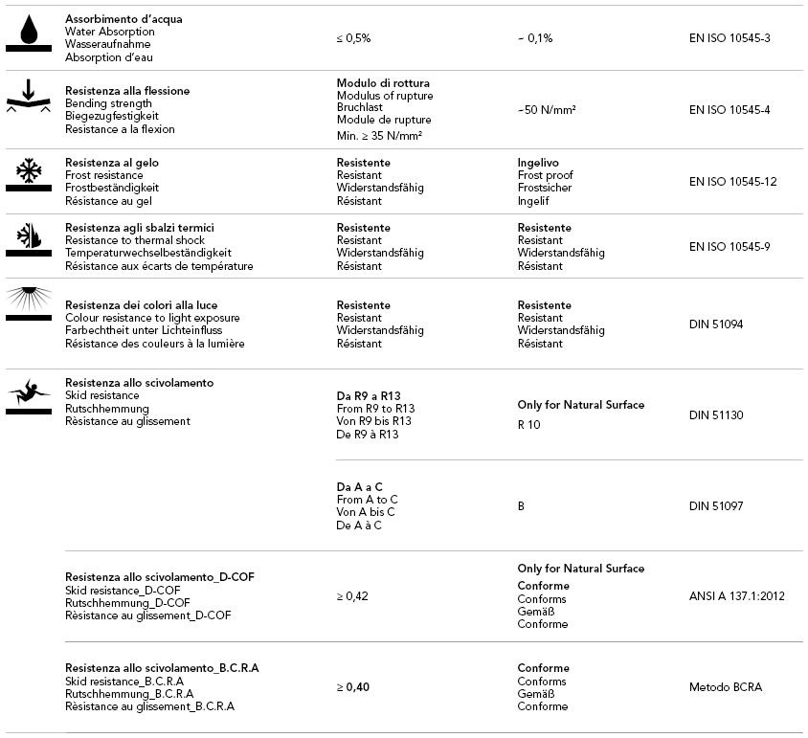
HSV 10 TERRAZZO STONE BIANCO
TORONTO
115 Carnarvon Street
Toronto, ON M6M 3C9
T 416 413 9008
F 416 413 9652
TROY
1700 Stutz Drive, Ste 92 & 94
Troy, MI 48084
T 248 643 6520
F 248 643 6523
Please note, all specifications have been supplied
by the manufacturer and are subject to change.
Email: mail@cercantile.com
Website: www.cercantile.com

